Slide 1


F1 Database Management System
This presentation covers the design and implementation of an F1 database management system.
Presented By:
•Ashwin Thankachan
•Varun Singh
•Shruti Dixit
•Yusheng Han
•Weijia Fang

Slide 2
Project Overview
The Formula 1 Team Management System tackles key challenges within a data-rich and highly competitive sporting environment.
By centralizing team operations, the system facilitates real-time decisions, efficient resource allocation, and strategic planning.
It enhances performance by integrating all facets of team management, spanning driver analytics to vehicle maintenance.
It addresses major challenges such as Driver Performance Analysis, Car and Part Maintenance, and Sponsorship and Financial Management.

Slide 3
Database Design
Driver
Race
Information about each driver in the database.
Details of each race event.
Race_Info
Car
Specific information related to each race.
Data on each car participating in the races.
Car_Parts
Tires
Information about the various car parts.
Details on the tires used in the races.
Season
Records
Information about each racing season.
Records and statistics from the races.
Sponsor
Driver_Standings
Information about the sponsors.
Driver standings for each race.
Team_Standings
Team_Staff
Team standings for each race.
Information on the team staff.

Slide 4
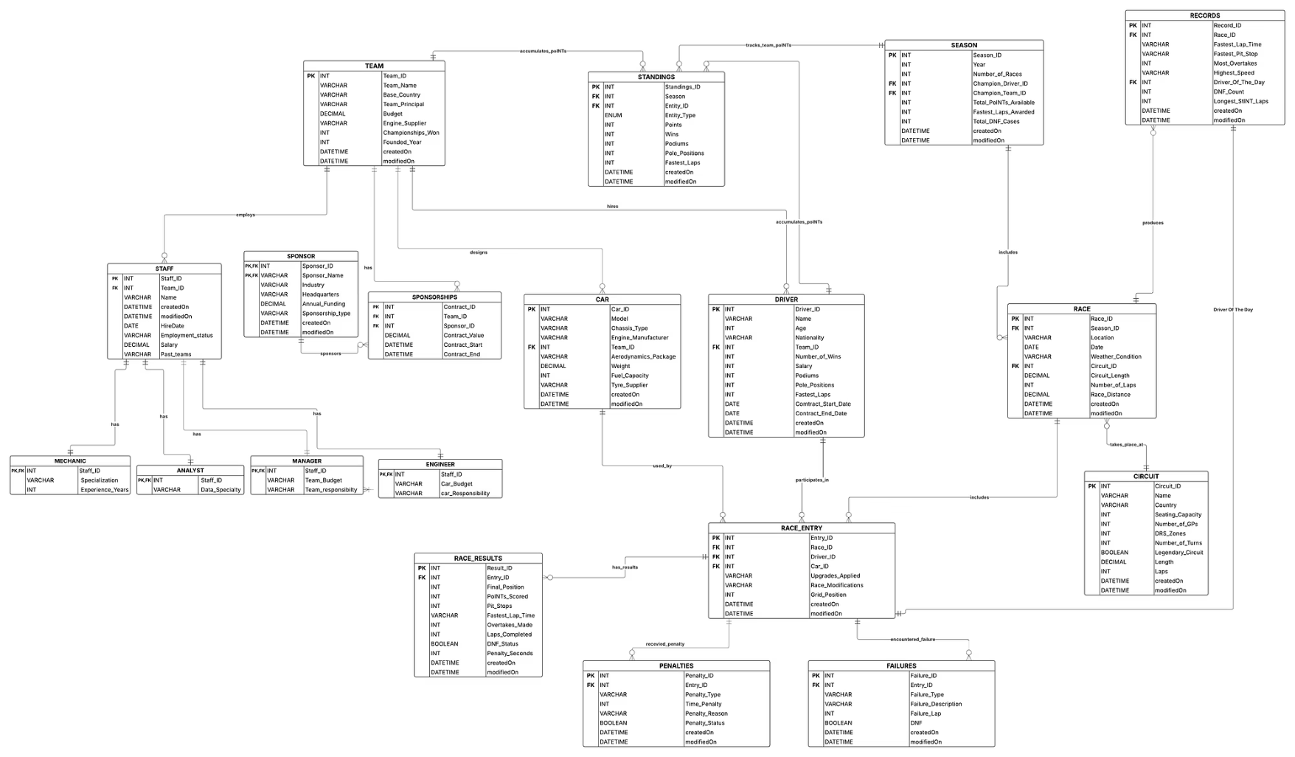
Logical ERD

Slide 5
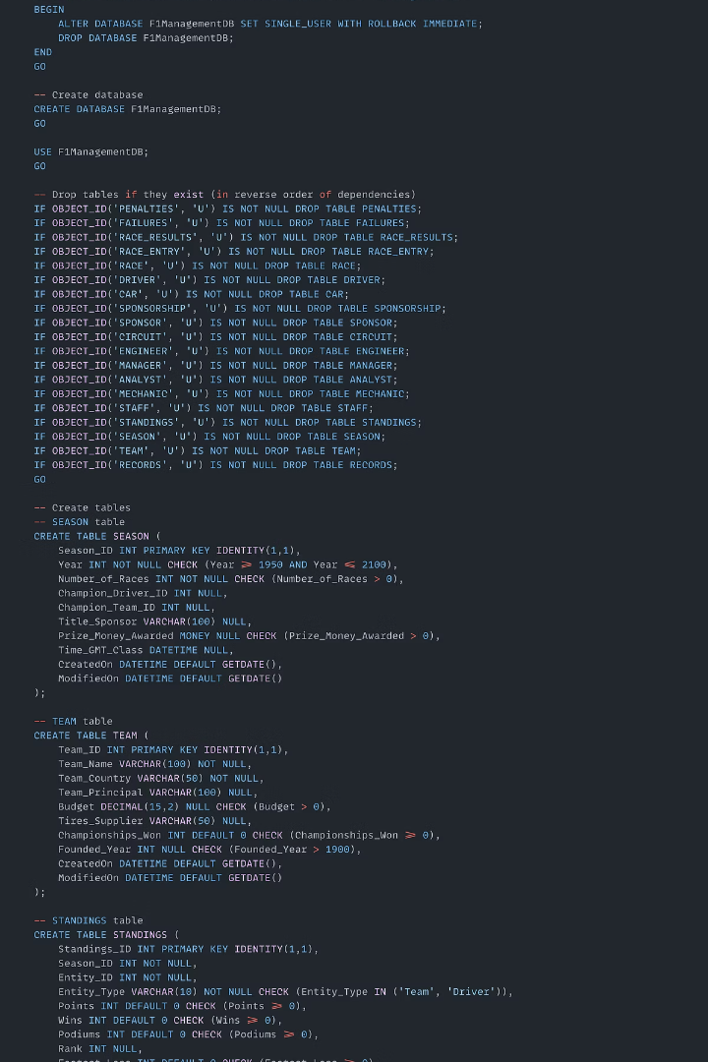
Data Definition
1
Tables
Define each table's structure.
2
Columns
Specify data types and constraints.
3
Keys
Establish primary and foreign keys.

Slide 6
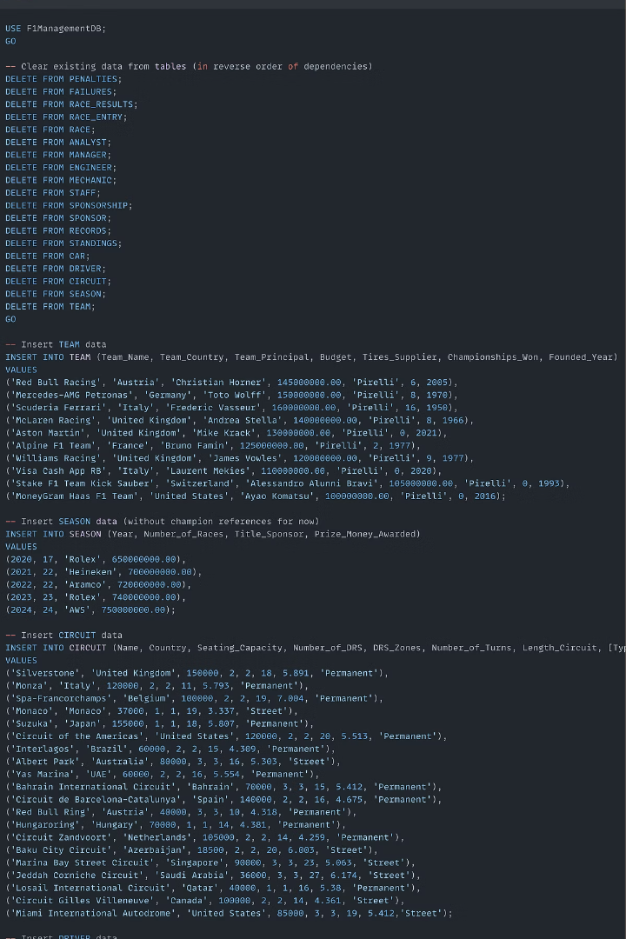



Data Insertion
Raw Data
Gather F1 results.
Transform
Clean and validate.
Insert
Populate tables with accurate race data.

Slide 7
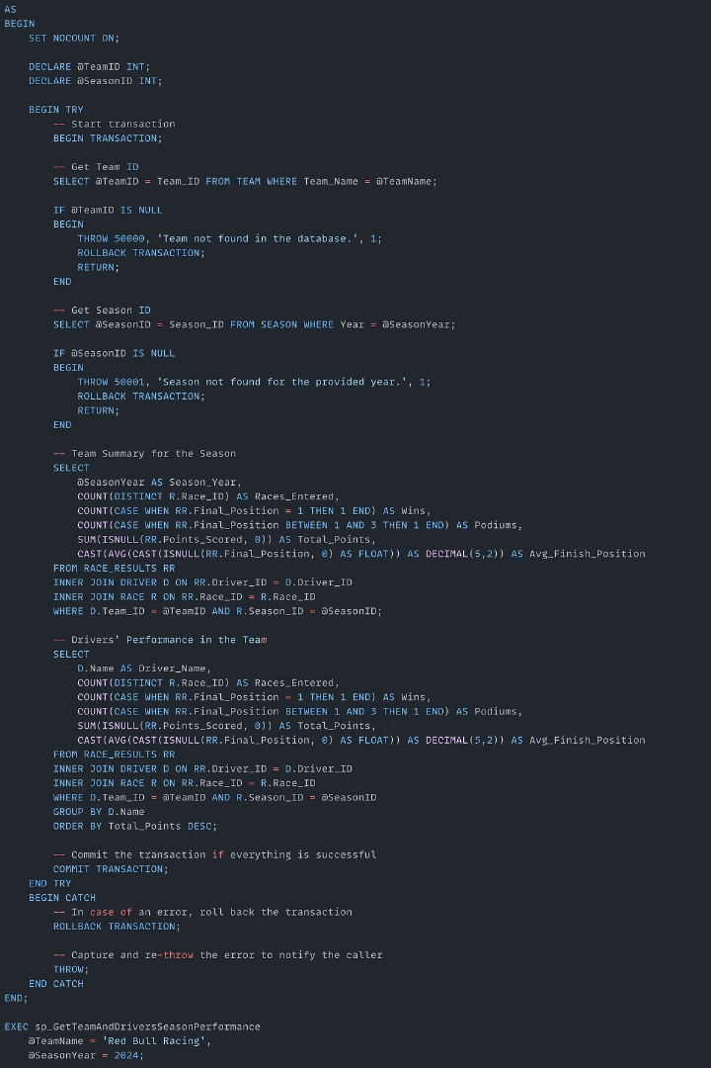
Stored Procedures
Stored Procedures
GetTopDriversByCircuit
GetDriverFullStats
GetTeamAndDriversSeasonPerformance

Slide 8
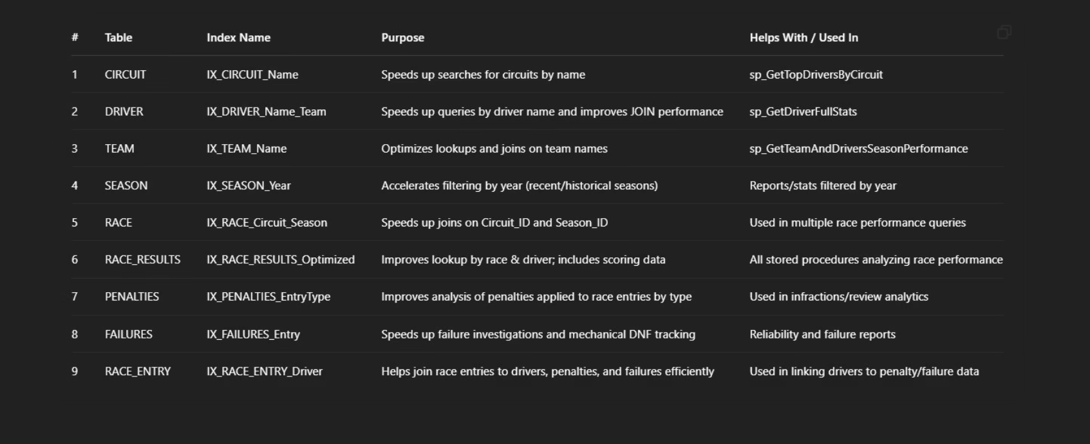
Clustered Indexes

Slide 9
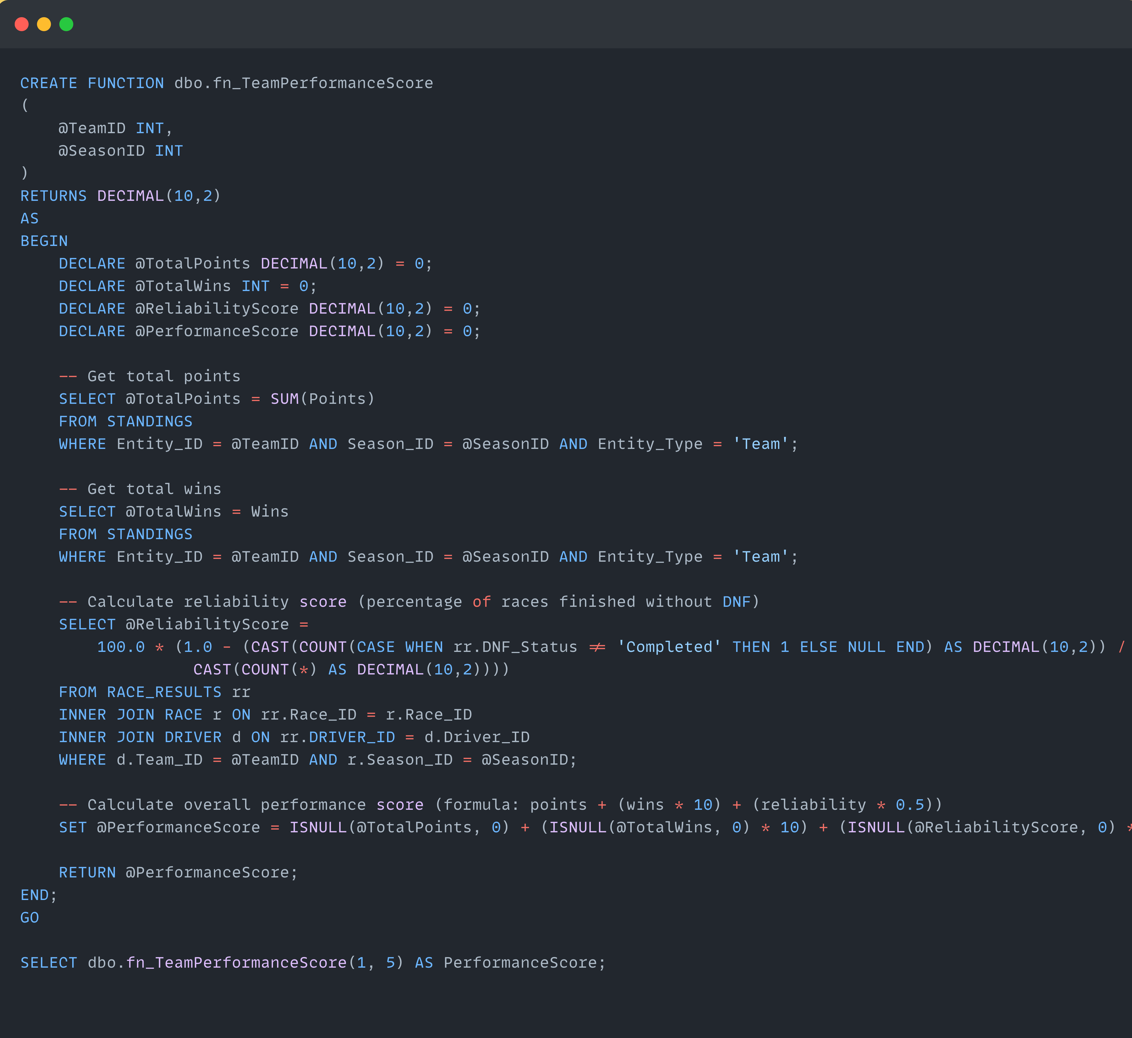
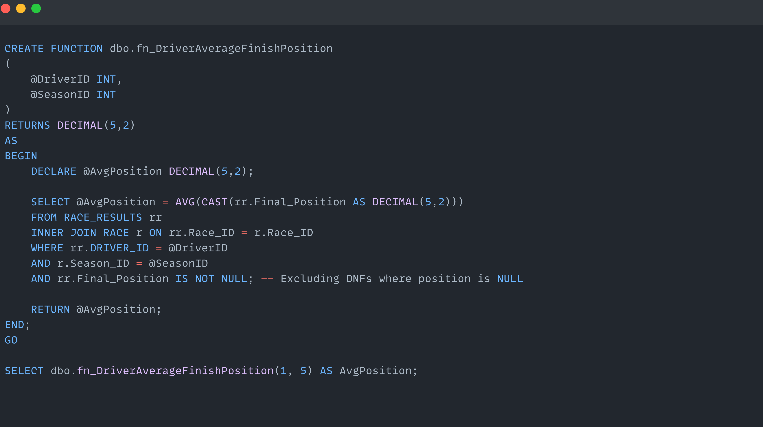
User-Defined Functions
DriverAverageFinishPosition
TeamPerformanceScore
MostSuccessfulDriverAtCircuit
DriverHeadToHead

Slide 10
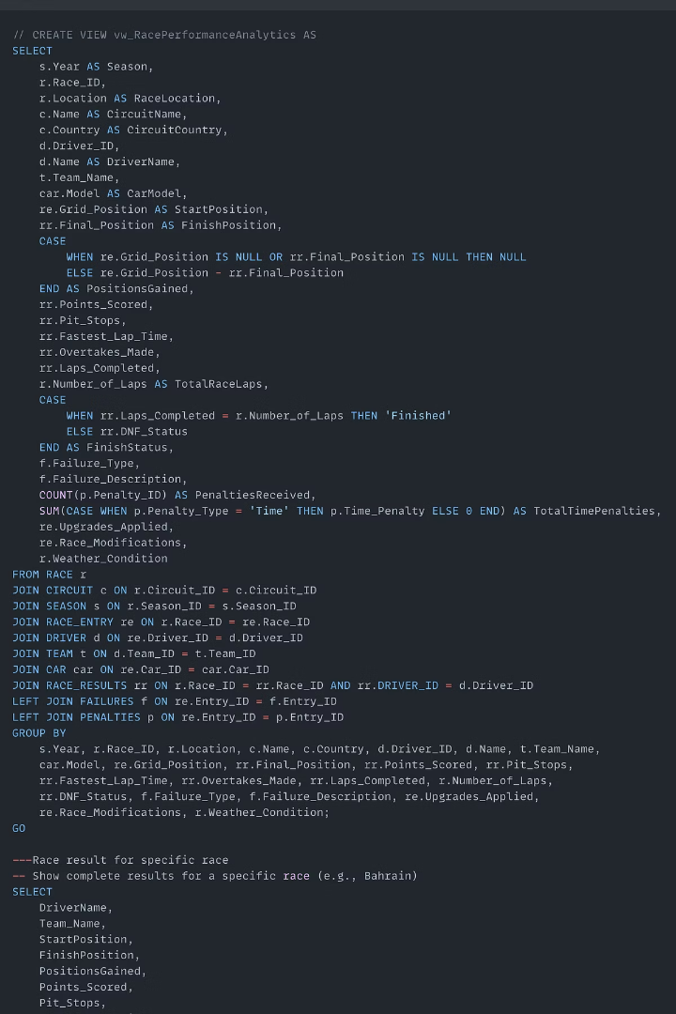
Views
ChampionshipStandings
RacePerformanceAnalytics
Team Resource Performance
CircuitStrategyAnalysis

Slide 11


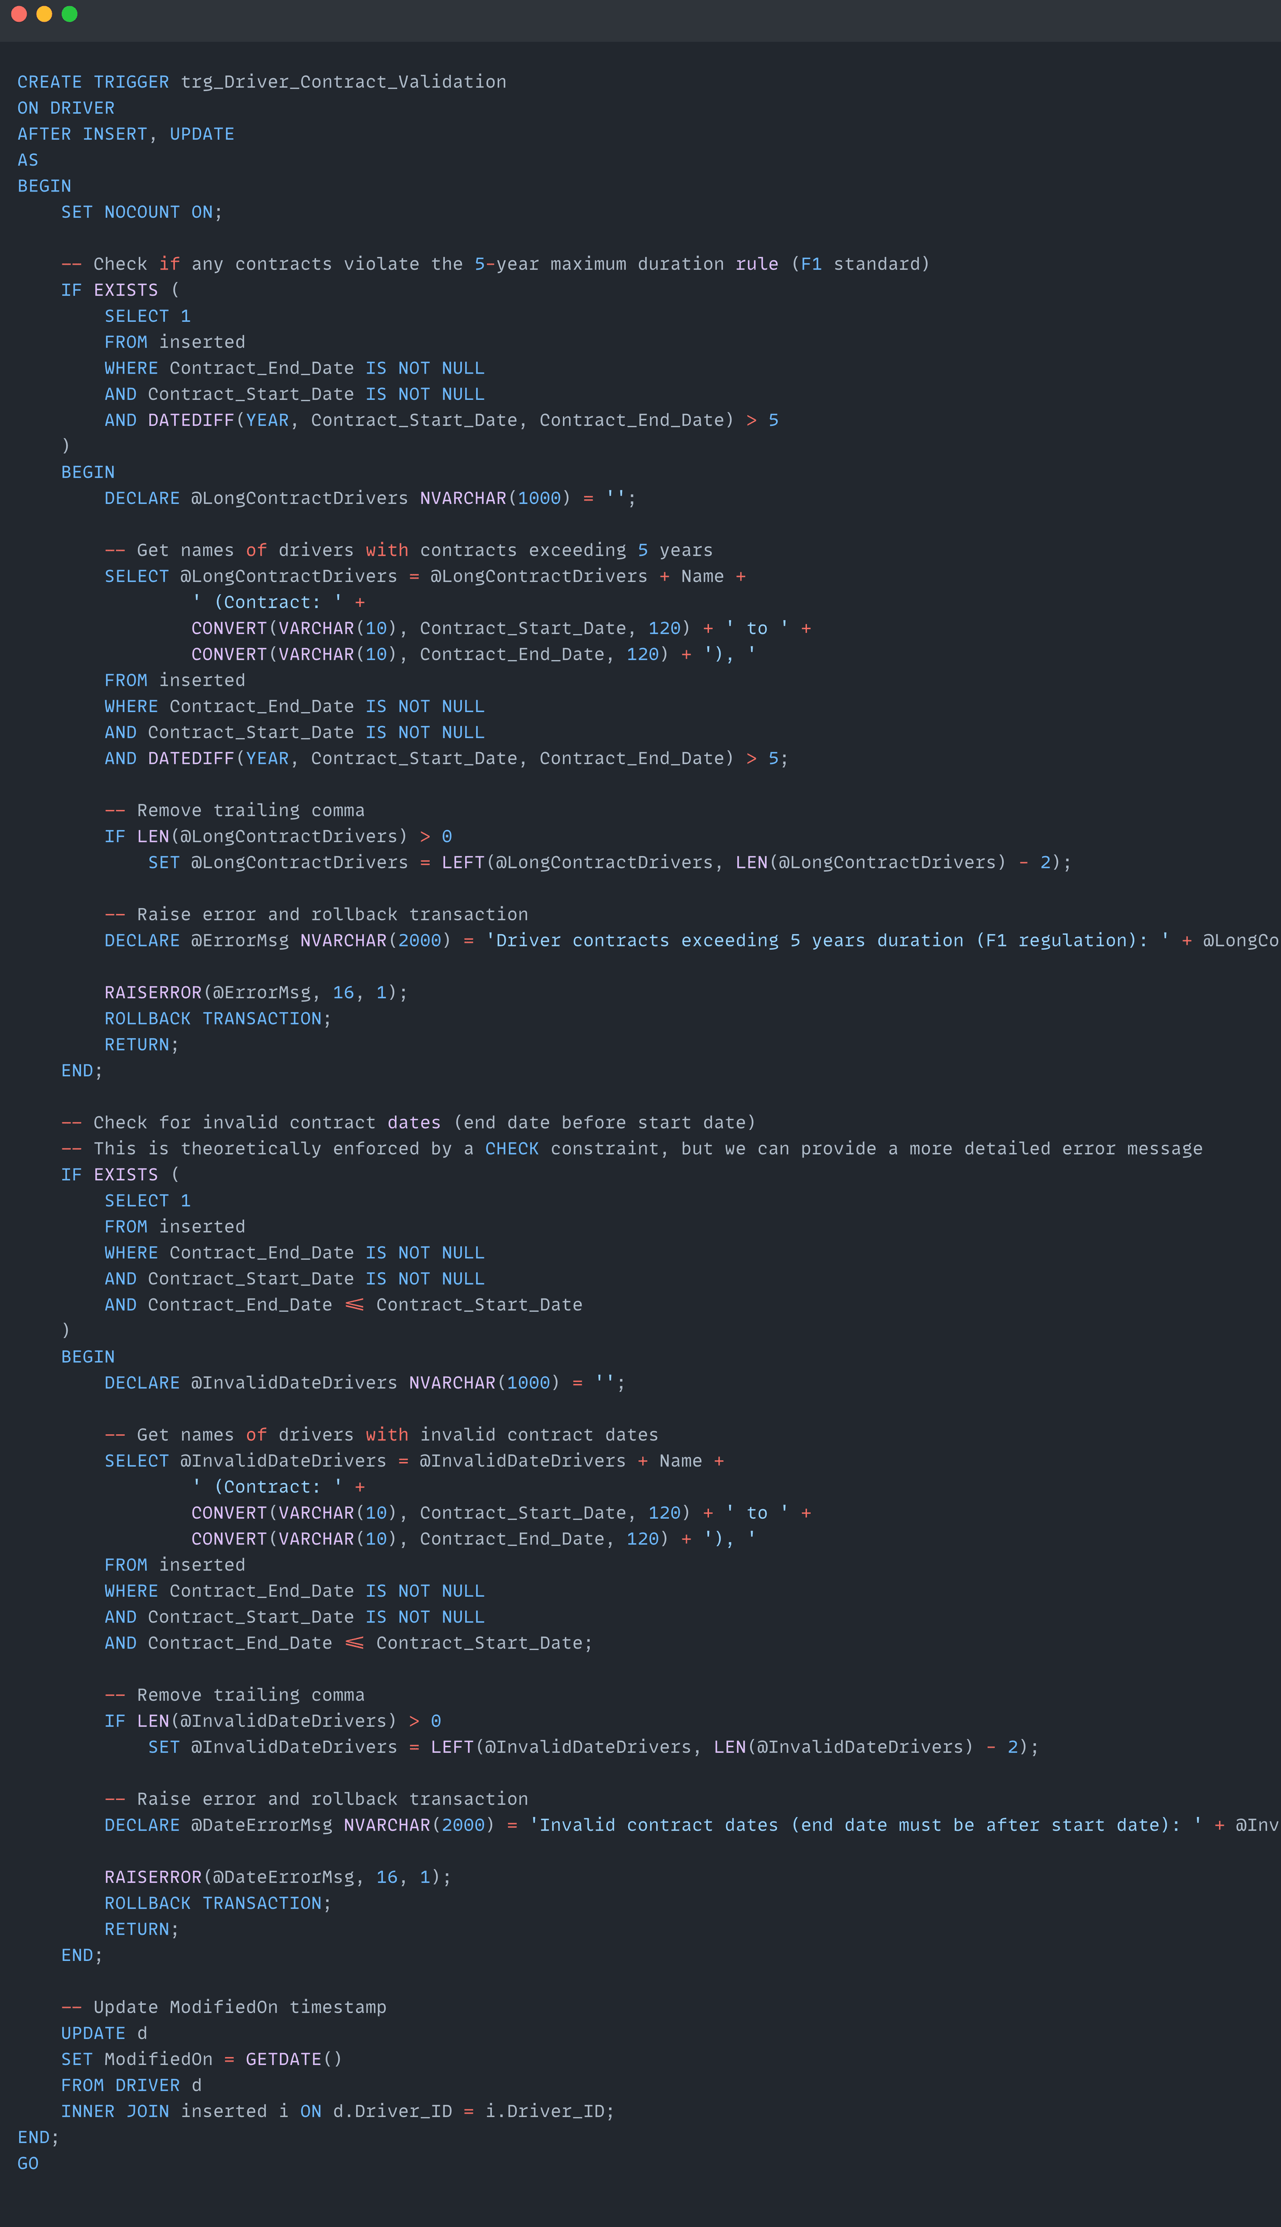
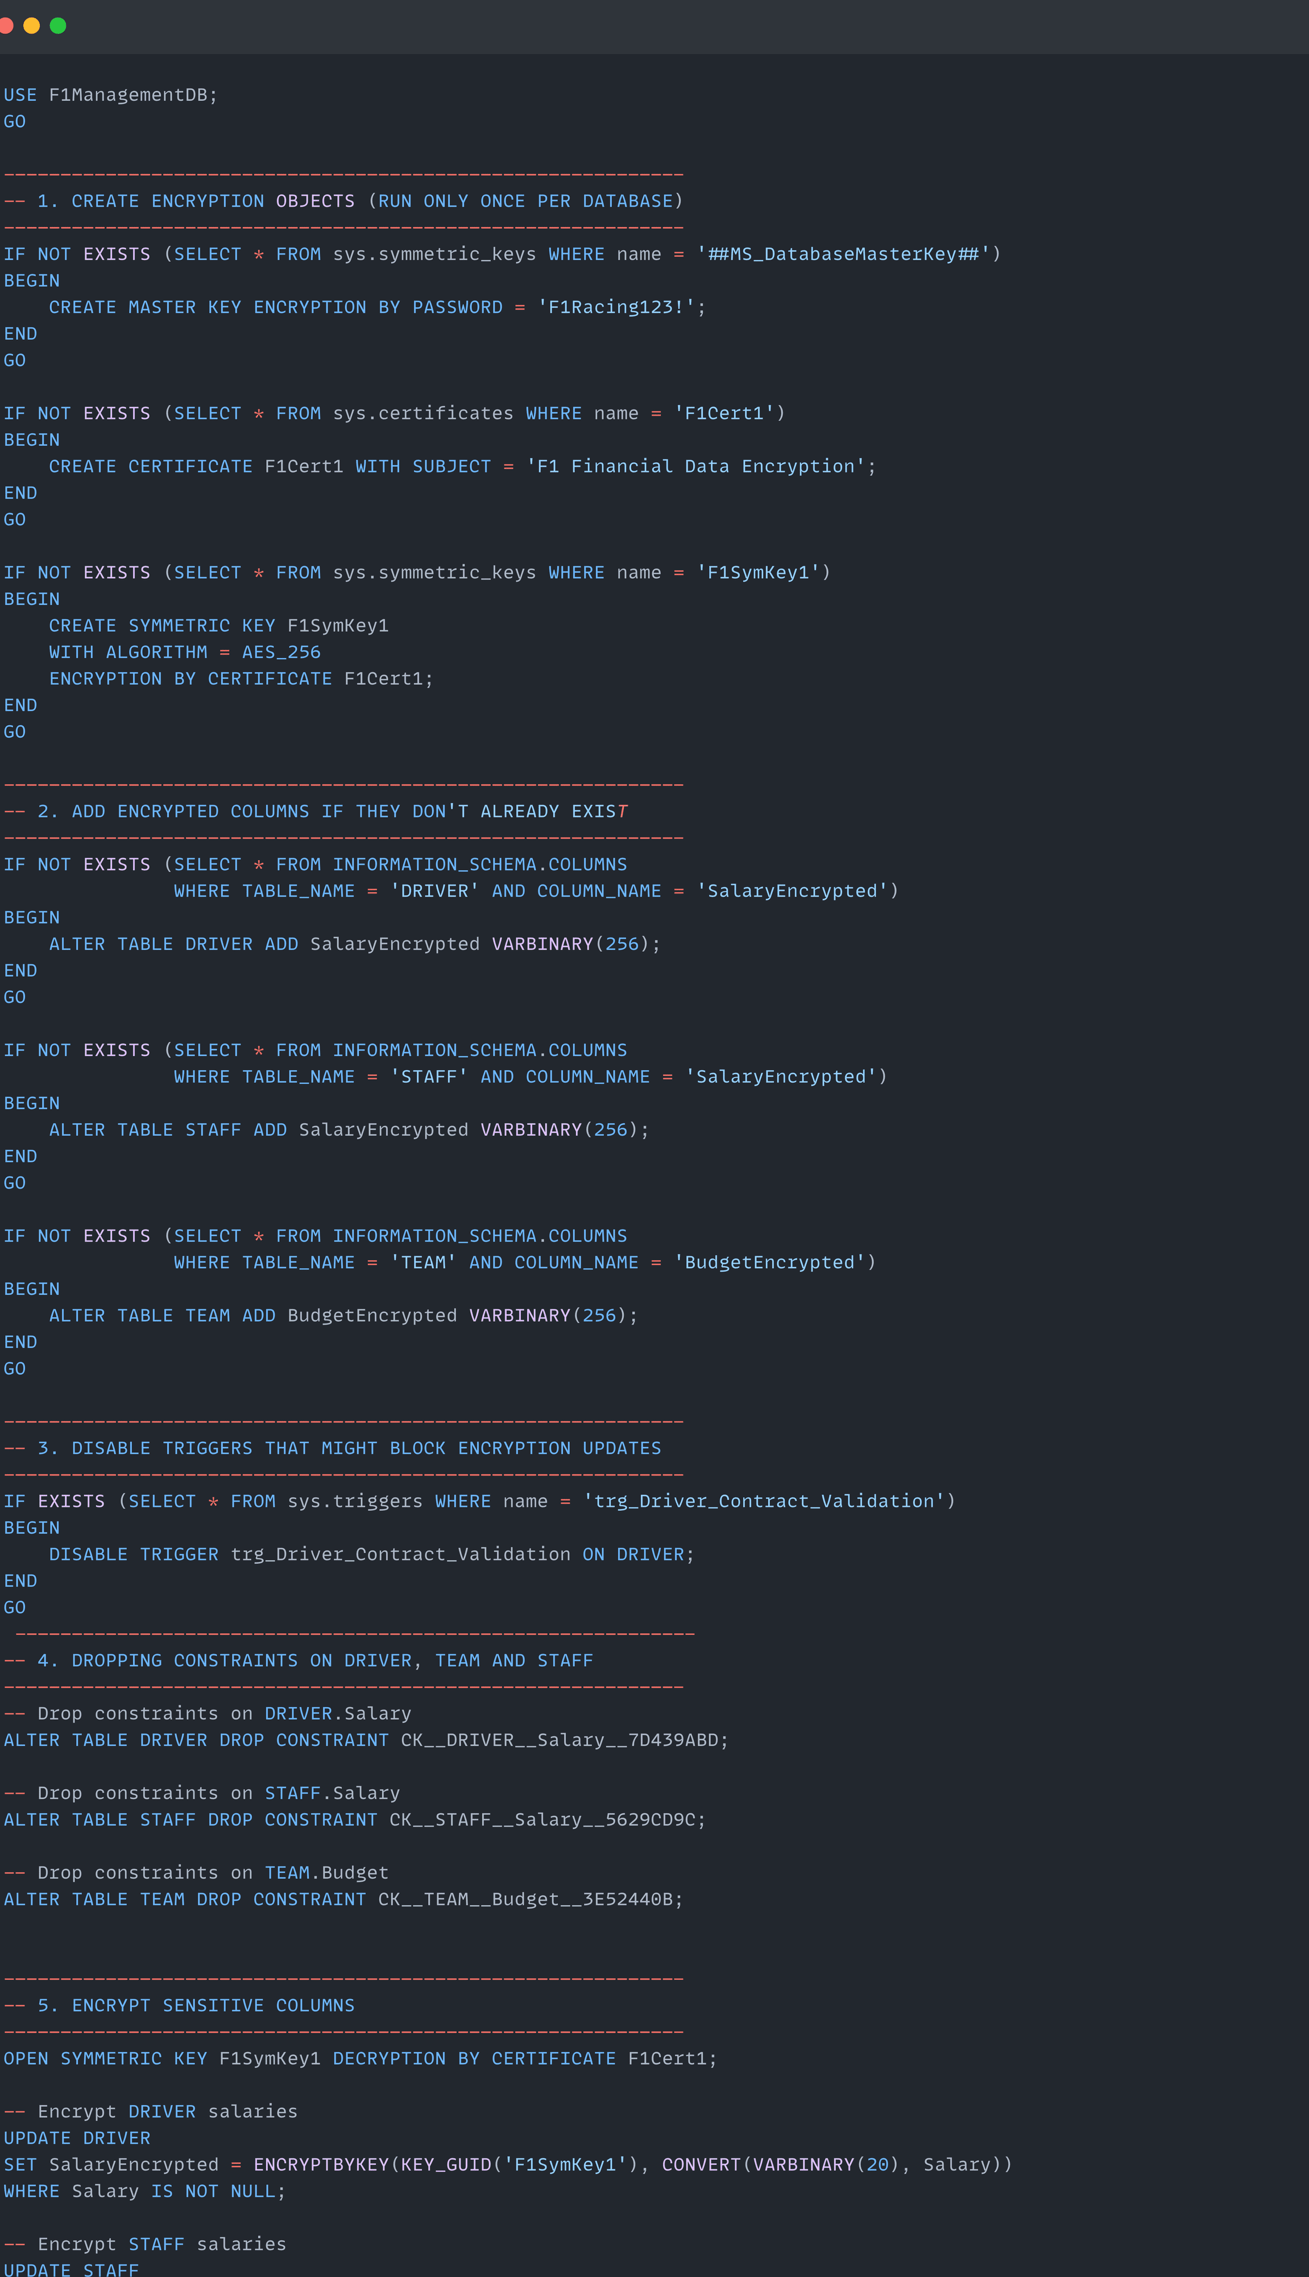
Triggers & Encryption
Triggers
Encryption
Driver_Contract_Validation
1. Driver salaries, team budgets, and staff salaries are encrypted to ensure confidentiality.

Slide 12
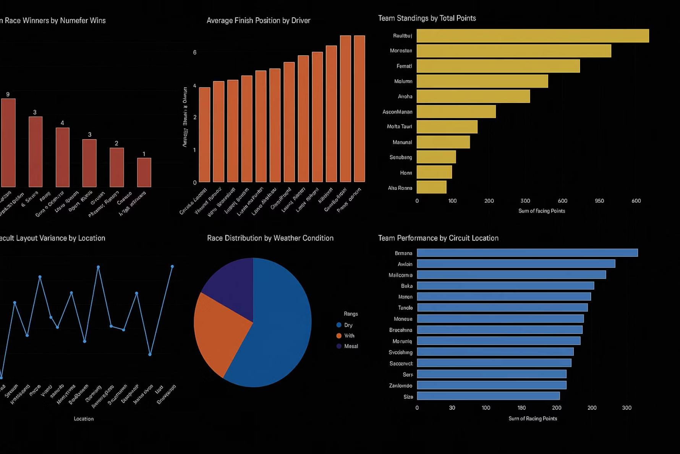
Visualization Report

Slide 13
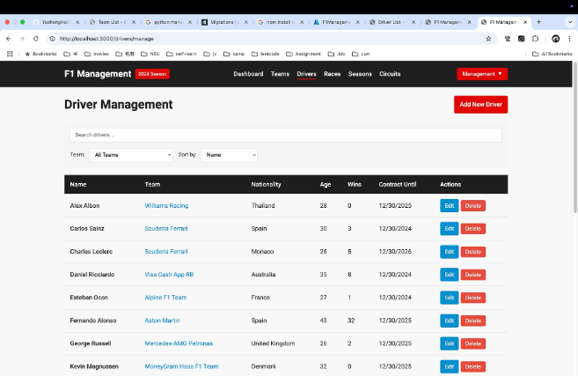
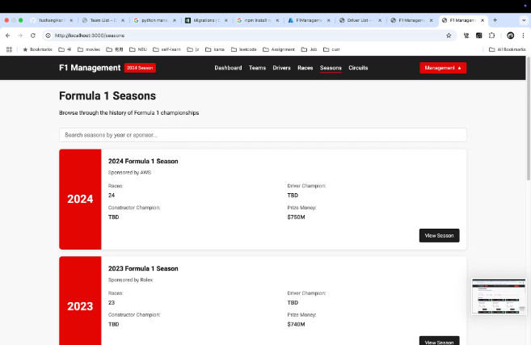
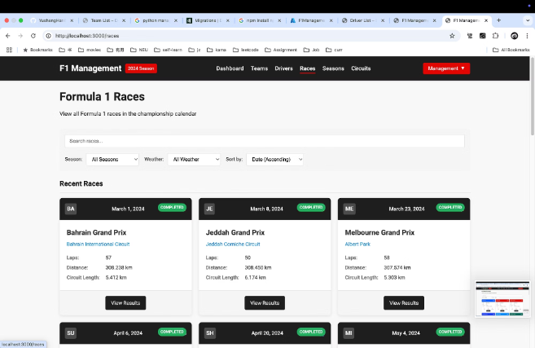
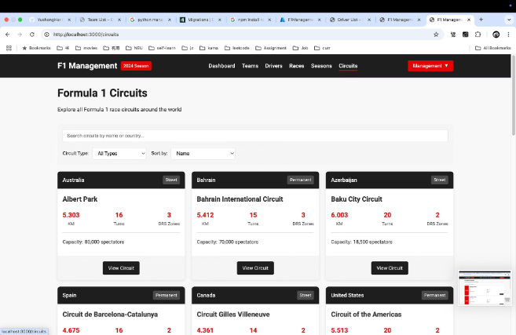
Sleek User Interface

Slide 14

THANK YOU!

